Slide 1
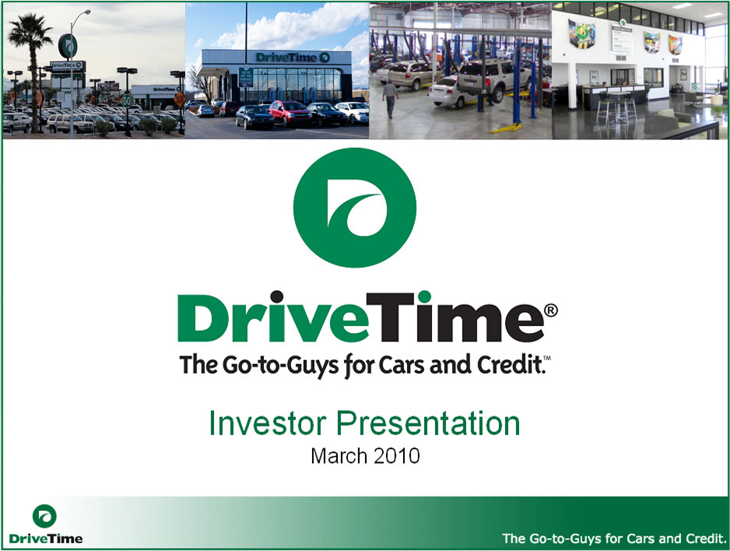
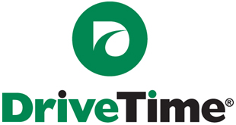
Investor Presentation
September 2013

Slide 2
TABLE OF CONTENTS
SECTION 1: COMPANY OVERVIEW
SECTION 2: CREDIT SCORING & LOAN SERVICING
SECTION 3: FINANCIALS
SECTION 4: SECURITIZATIONS
SECTION 5: LEGAL & REGULATORY UPDATE
2
We Bring People and Cars Together.

Slide 3
SECTION 1: COMPANY OVERVIEW
3
We Bring People and Cars Together.

Slide 4
Company Overview
DriveTime Automotive Group, Inc. (“DriveTime”) is the leading used vehicle retailer in the United States solely focused on the sale and financing of quality vehicles to the subprime market. Its sister company, DT Acceptance Corp. (“DTAC”), funds and services all loans originated by DriveTime.
Over the past 20 years, DriveTime has developed and operated an integrated business model that provides its customers with a comprehensive end-to-end solution for their automotive needs, including the sale, financing and maintenance of vehicles.
DriveTime is privately held (Ernie C. Garcia II, Chairman, owns 98.3% and Raymond C. Fidel, CEO, owns the remaining 1.7%), but is an SEC registrant due to its $250M Sr. Secured Notes issuance
DriveTime has 104 branded dealerships and 18 reconditioning facilities in 47 geographic areas. For the last twelve months ended June 30, 2013 DriveTime has:
    Sold 63,011 vehicles
    Generated Revenue of $1.3 billion
    Generated Adjusted EBITDA of $149 million
    Generated Adjusted S-Corp Net Income of $46.5 million
    Managed a retail loan portfolio of $1.8 billion
*
* Adds back $11.1m of unrecognized Deferred Income on 6/30/13 Balance Sheet as a result of unbundling service contracts at point of sale. Piloting in 4 states starting December 2012.
4
We Bring People and Cars Together.
Notes:
Original $200M Sr. Note Issuance: Initially sold in June 2010 at 12 5/8, recent $50M upsize sold to yield 107.7 (sold in May 2013)
Updated through 6.30.13:
Vehicle Sales through 6.30.13: 36,893 + 26,118 = 63,011 (59,930 – 33,812 = 26118)
Net Income: 2012: 59353 – 62121 = -2768 +38154 = 35386
12.31 Adjusted EBITDA – 160.1 – 108.7 (adjusted EBITDA through 6.30.12) = 51.4 + 98 (YTD adjusted EBITDA through 6.30) = 149.4M
Revenue: 752,043 through 6.30.13, 10k: 1,222,866, 6.30 10Q 670,040 = 1,304,869 TTM

Slide 5
Company History
2009:
First unwrapped securitization
Drive Care 36mo/36k mile warranty
2005:
Issued $80M senior unsecured notes (later upsized to $136M)
2012:
$1.7B Loan Portfolio
Launched GO Financial
1996:
Took company public
Raised $160M in IPO and secondary
7 dealerships in Arizona, $54mm in sales
2008/2009:
Closed 26 stores & decreased originations 29%
2001:
Implemented 1st generation credit grading system
2013
2012
2011
2009
2010
2006
2008
2013:
Issued $50M Sr. Secured notes tack-on
104 Dealerships
2002
2005
2011:
Sr Notes registered with SEC
7th generation credit grading system
Wells Fargo warehouse/inventory lending facilities
1998
2001
1996
1992
1998:
Began monoline wrapped securitization program
2006:
Revenues top $1B
Loan portfolio in excess of $1B
1992:
Founded as Ugly Duckling Corporation
2010:
Payments removed from stores
Centralized collections
Issued $200M Sr. Secured Notes
Four warehouse lenders totaling $575M
2002:
Taken private
Developed and implemented new strategic focus
Changed name to DriveTime
5
We Bring People and Cars Together.
5
Notes:
2005 – If speak about SCUSA, note Steve Z. – DT second in command (in risk/credit) taken from us around 2005
2008/2009 – Issued private securitizations w/SCUSA which helped to get through credit crunch (rate on PALPS approx. 11%)
- up to 103 stores prior to the store closures
- Ernie Garcia put $100M back into the business as a result of advance rate reduction (essentially a large capital call that took place with our warehouse lenders)
2009 – Used MBIA/EXCEL capital as monoline insurers prior to 2009
2013 – Anticipate 8th generation scoring model in Q4 2013, New Point of Sale system in Q4 2013

Slide 6
Expanding Coast-to-Coast Footprint
Dealerships located in 47 metropolitan areas in 19 states
  All Company owned
In recent years, the DriveTime brand has evolved from a traditional buy-here, pay-here dealership model to a comprehensive retail experience
The Company’s dealerships are retail focused and facilitate the sale of vehicles through dealerships with a customer centric focus
Entered seven new states since March 31, 2010 (dark green states)
Cincinnati (2)
Columbus (1)
Indianapolis(2)
St. Louis
Richmond (3)
Denver (2)
St. Louis (1)
Norfolk (3)
Las Vegas (3)
Chattanooga
Greensboro (2)
Las Vegas (2)
Nashville
Nashville(2)
Raleigh
Los Angeles (4)
Tulsa
Memphis(2)
Knoxville
Greenville
Fayetteville
Phoenix (7)
Oklahoma City(2)
Charlotte (5)
Phoenix (5)
Huntsville
Columbia
Myrtle Beach
Albuquerque (3)
Little Rock (1)
Birmingham (2)
Charleston
Jackson
Atlanta (5)
Savannah
Tucson
Dallas (8)
Montgomery
Augusta
Temple
Columbus
Austin (2)
Mobile
Pensacola
Tallahassee
Jacksonville (3)
San Antonio (4)
Houston (3)
Orlando (6)
Tampa (5)
Fort Meyers
Miami (2)
McAllen
Dealerships (104 Total)
Reconditioning Centers (18 Total)
Collection Centers (2 Total)
We Bring People and Cars Together.
Notes:
RETAIL: (New locations: Augusta, Fort Meyers, Pensacola, Louisville, Columbus #2 - open on Sept. 6th)
- Project that we will open 10 -15 stores per year (New stores – ½ fill in, ½ new locations)
- Items we consider when selecting a location for a retail store:
Regulations (reason why we have elected to not do more business in CA, may look to get back in over next few years – High advertising cost as well)
Advertising Cost/Coverage – project within the next couple of years will be able to advertise nationally
Demographics: Income Levels/Population Size
Taxes/Sales Taxes/Usury Rates
Louisiana – Tough repo laws – chosen to stay out of there for now
RECON CENTER:
-Geographically located – focused on where auctions are as well as proximity to dealerships
-Looking in the Northeast (Pennsylvania) as our next IC location – proximity to largest vehicles auctions in the world - Manheim, etc. – Can get cheaper priced vehicles in this location even w/transport to dealerships relative to some vehicles purchased further south in Charlotte/Birmingham, etc.)

Slide 7
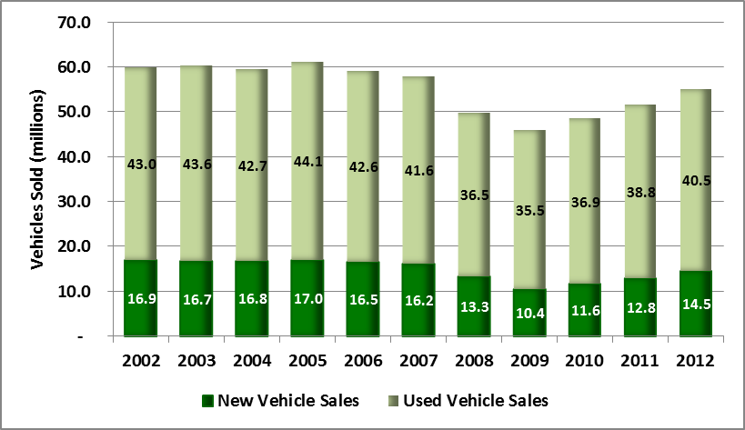
Nation’s Largest Subprime Vehicle Retailer
New and Used Car Sales
Top Used Vehicle Retailers
2012 rank | Company | 2012 No of used vehicles sold⁽¹⁾ | 2012 market share⁽²⁾
1 | CarMax (KMX) | 408,080 | 1.0%
2 | AutoNation (AN) | 180,973 | 0.4%
3 | Penske Automotive (PAG) | 145,580 | 0.4%
4 | Sonic Automotive (SAH) | 105,615 | 0.3%
5 | Group 1 Automotive (GPI) | 85,366 | 0.2%
6 | Van Tuyl Group (private) | 81,385 | 0.2%
7 | Hendrick Automotive | 60,174 | 0.2%
8 | DriveTime Automotive | 59,930 | 0.2%
Source: Automotive News.
As a % of total 2012 used vehicles sold by franchised and independent dealerships and private sales (40.5 million). (Source – CNW)
Source: CNW.
We Bring People and Cars Together.
Notes:
- 3rd largest branded used vehicle retailer and privately held retailer
-Largest branded subprime vehicle retailer
Average age of vehicle on the road is at all-time highs (11 yrs.) – This coupled with the economy slowly coming around new vehicle sales are almost back to pre-recession levels which should mean that used vehicle pricing at auctions should start leveling off or even coming back down. Have an auction recovery slide in deck that shows this trend starting to occur.
Company Notes:
Continued focus on customer experience @ dealership
Right mix of inventory on the lot – introduced small mix of some Euro’s to keep the repeat customer as well as the higher income, higher FICO customer
Slight shift in marketing strategy from a tagline focused on bad credit (Approved, Approved, Approved) to a line targeting a broader customer base and place some focus on the car we offer (We bring people and cars together). Goal is to not only maintain the customers with bad credit coming to us, but to also capture customers that are slightly up the FICO scale. With the opening up of credit our Competitors are lending to subprime (which used to fall to us) and we have to find ways to counter.
DT Competitors: Carmax – Top End15% - 20% of our customers (Carmax also buying 100k vehicles, Mid/Low end – Car Mart, JD Byrider, Mom and Pops BHPH

Slide 8
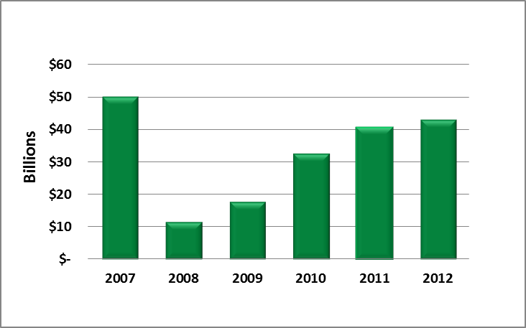
Sub Prime Vehicle Finance
Percentage of U.S. population with a FICO score under 620 is approximately 24.5%
Originations for customers within the subprime used vehicle market averaged $32.6 billion per annum over the last 6 years
Subprime Population
Subprime Auto Loan Originations
Subprime population 24.5%
Prime & Nonprime population 75.5%
Source: Equifax - FICO Distribution for borrowers with FICO scores below 620 as of April 2013.
Source: CNW. Subprime defined as borrowers with FICO scores below 620 for originations data.
We Bring People and Cars Together.
Notes:
Subprime Approval Rate up: See if I can get some #’s from CNW
2009/2010 – some of DriveTime’s best vintages due to less competition and DT being a big player in the subprime market
Carmax – Over past 12 – 18 months have increased subprime originations (approx 2x) from 8% to 16% - this is one area where they could grow – selling off to ACA/Santander and financing a few themselves
Subprime loan performance was the least volatile during the recession – best performing niche of the auto sector ( largely attributable to the already high charge – off rates)

Slide 9
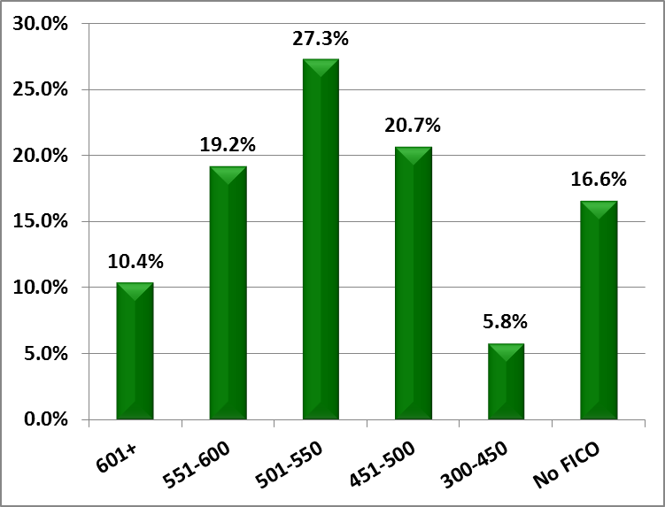
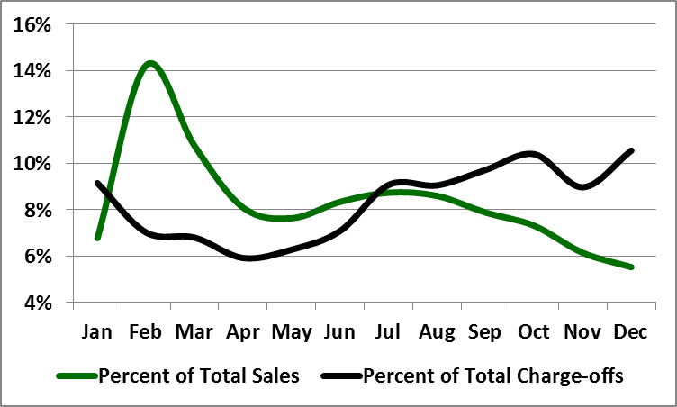
DriveTime’s Customer Base
Subprime customers generally have:
- Poor or limited credit histories
- Significant charge-offs
- Prior bankruptcies
- Modest incomes
Tax refunds result in high seasonality of our subprime business
- Higher downs = Higher Q1 sales
- Delinquencies and charge-offs drop as
customer has more disposable cash
- Majority of profits made in first half of year
- Inventory levels highest at year end in
preparation for Q1 sales volumes
- Tax returns were delayed in 2013, shifting
more vehicle sales into March and April
DriveTime Customers
Subprime Seasonality
Source: DriveTime originations last 12 months ended 3/31/2013 Source: DriveTime sales and charge-offs for 2010-2012
We Bring People and Cars Together.
Notes:
Typical BHPH = 0 - 550 FICO, $3k - $5k Car, Markup 50%
DriveTime = 450 – 600 FICO, $8k - $9k Car, Markup 35%
Carmax = 550 – 650 FICO, $12k - $20k Car, Markup 15%
Exeter also plays up in the 550+ FICO range
Seasonality of Tax season this past year was a little different – more of a flat hill that spanned the latter part of February into mid- April (due to delays in processing tax returns/finalizing tax laws)
Future Update – Stack apps next to FICO bands to show the high proportion of apps with High FICOS turn into deals (A/B grades - ~ one in every 2 apps.) Typically the better graded customer has the higher FICOS (but not always)
<\\phx-corp-fs01\departmental shares\Treasury\Presentations\2013\Support\ASF Chart Seasonality and Total Sales Chart.xlsx>
\\phx-corp-fs01\departmental shares\Treasury\Presentations\2013\FICO Bands through 12.31.12.xlsx

Slide 10
Fully Integrated Business Model
Vehicle Acquisition
Acquired primarily from used vehicle auctions (including online auctions)
Centralized vehicle selection strategy takes into account retail value, age, and costs of buying, reconditioning, and delivering the vehicle for resale, along with buyer affordability and desirability
Purchased 78,190 vehicles from over 250 auctions nationwide during 2012
Vehicle Reconditioning and Distribution
Subsequent to acquisition, vehicles are transported to one of DriveTime’s 18 regional reconditioning facilities
DriveTime reconditions the vehicles and perform a rigorous multi-point inspection for safety and operability
Reconditioned vehicles are distributed to dealerships based on real-time projected inventory turn times and levels
Vehicle Sales
DriveTime employs proprietary inventory management and pricing systems which are integrated with and into its credit scoring system to facilitate the optimum vehicle for its customers' needs
No-haggle vehicle pricing is displayed on each vehicle's sticker - prices are determined centrally for all dealerships and all regions
Marketing
Utilize targeted television, radio and online advertising
Over $28 million in marketing spend in 2012 with over 260,000 TV commercials and 11,000+ radio spots
Underwriting and Finance
Centralized proprietary credit scoring system determines a customer’s credit grade and the corresponding minimum down payment and maximum installment payment
Monitor the performance of our portfolio and close rates on a real-time basis
Loan Servicing
DriveTime performs all of its own servicing functions, from collections through the resale of repossessed vehicles
All collections conducted through DriveTime’s centralized facilities in Arizona, Texas and Barbados
Customers can make cash payments through an electronic payment network at over 4,000 Wal-Mart stores and more than 17,000 other locations nationwide - payments can also be made online, by check, money order, bill-pay and ACH
After Sale Support
DriveCare® 36 month/36,000 mile limited warranty/service contract covers major mechanical and other electronic components of the engine block, the transmission, climate control and drive axles
We Bring People and Cars Together.
Notes:
Vechicle Acquisition - Approximately 95% of vehicle purchased are through Manheim/Adessa – 73% through physical auction, 20% online (Openlane/Adessa, SmartAuction/Ally, OVE/Manheim, etc.)
Vehicle Sales – Put 9 pictures of vehicle on-line, Deal Structure is centralized, look at car, down payment available, customer grading score, to determine deal structure. Customer can qualify for any vehicle on lot if they can come up with enough down. Manager approval required for exceptions in order to get a deal to close.
Marketing – Anticipate spending slightly more in 2013 (Approx. $30M) TV/Radio $21M, Pay per click $3.6M, 3rd party leads $2.3M, Production/Agency $3.1M
Other – We have a 5 day vehicle return program – see approx. 1% utilization of this. We cover most vehicle issue w/in 30 days as ASR, after 30 days it is considered part of the warranty and would be subject to a deductible.

Slide 11
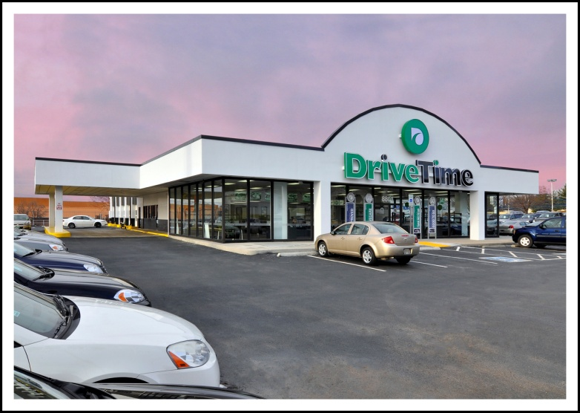
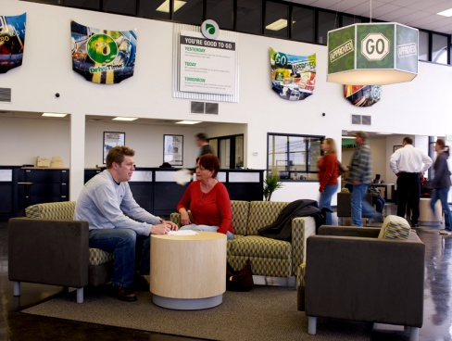
104 DriveTime Dealerships – All Company Owned
Typical Dealership
Units sold per month |  | 55
Vehicle inventory |  | 74
Sales financing | 100% of sales
Staffing |  | 10 – 15 retail and ops employees
Dealership building size |  | 5,000 sf
Leasehold improvements & equipment |  | $595K
Typical lease term |  | 5 years, with option for 5 to 15 years
Knoxville
Note: Information is based on the twelve months ended June 30, 2013.
Nashville
Notes:
Lease payments are around $10K - $12k – 4 -5 yrs. Ago we were paying up to $35k for the same lease. (Need to confirm: 9 co. owned stores?, 2 owned IC’s?)
Dealerships – capitalized on the recession by entering into leases in dealerships exited by franchises during the downturn, many of these are in auto row locations, some even have extra space to service vehicles (not utilizing today, but could elect to use space in the future – servicing of warranty is outsourced with Aeverex/Ethos, w/DT bearing risk)
Taking collections out of the stores made it so we were able to close down some of our dealerships and make our dealerships more of a destination location. Where we used to have 3 or 4 stores, we now can get into a bigger/better location with 1 store (don’t need to be close to the customer in order for them to make their payment – taking payments out of stores is also very beneficial for our lenders/bondholders)
Avg. approx. $15M - $18M portfolio per dealership. Typically a 6 mo. Ramp up and $1.5M - $2.0M initial investment in inventory. (Approx. 8 mos. to GAAP break even, 16 – 24 mos. to Cash Flow Positive)
Staffing at Dealerships – (Different from typical dealership) Salaried Employees w/team based commissions, 90%+ college graduates, typically some retail big box store type experience, not require to have been in car sales, have career paths set up to enter as a Lot Attendant/Sales Associate and move up into Sales Manager, General Manager, Regional Manager, etc.
Updated/Verified by Tiffany

Slide 12
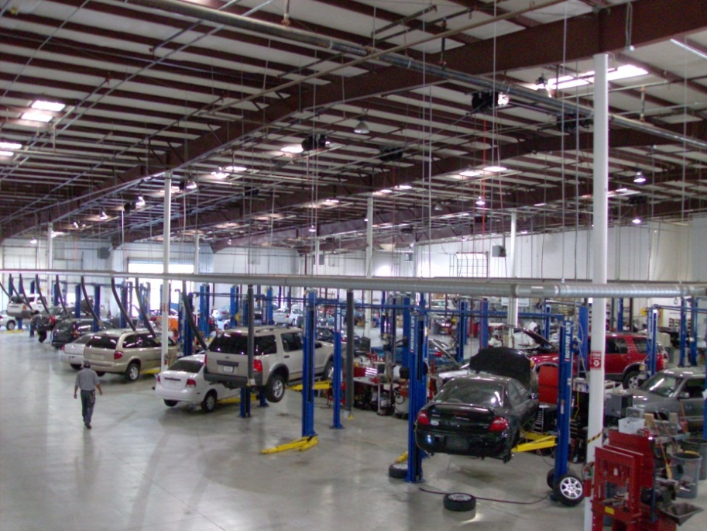
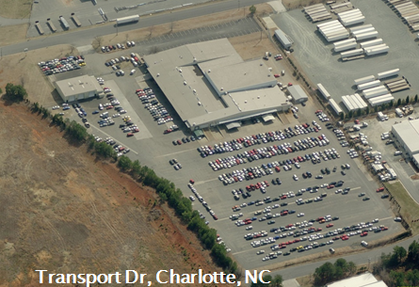
18 Reconditioning Facilities
Centralized Decision Making
  -Auction buy direction (year, make, mileage)
  -Distribution to recon centers and stores
  -Vehicle retail pricing
35 Full-Time buyers attending 250 auctions annually and purchasing over 84K vehicles
  -Avg. vehicle base cost is $8,000
  -Avg. reconditioning $1,500
  -Avg. odometer 84K miles
  -Avg. model year 2007
Total of +665,000 sq. feet of building space with maximum capability of reconditioning 2,290 vehicles per week
  -Multi-point inspection on all vehicles
  -Ability to recondition all makes and models
Blue Mound, Dallas, TX
NOTE: Information presented is for LTM ended 6/30/13.
12
We Bring People and Cars Together.
Notes:
- Get pre-sale feeds from auctions to review vehicles that will be up for sale, 35+ full-time buyers attending auctions weekly (including full-time on-line vehicle buyers as well – currently at 20% of purchases are on-line anticipate this increasing in the future)
-Typically open 1 IC for every 6 – 8 retail locations
-Newest IC is in Columbus, Ohio
-No warranty work on DT sold vehicle is performed in our IC’s – use Ethos/Aeverex and outsource the work to In –network/ out of network venders - pay a lower deductible if use an in network vendor, DT bears risk of warranty, Ethos is servicer
-recently broadened inventory selection in an attempt to attract customers
Lean methodology – more like a manufacturing facility, focuses on time to complete a specific task with one/two people assigned to a set of tasks (able to career path employees this way as well – i.e. start out changing oil and brakes, etc.) tools/timing the same at each IC location
Do sublet some work where it makes sense
-Discuss mini IC concept – Birmingham IC (for example)?
-Use 11 x 17 to discuss any inventory related questions such as avg. vehicle age, mix, mileage, turn times, etc.
6.30.13 update obtained from Daniel Ballenger – Maintains the inventory 11 x 17 master schedule

Slide 13
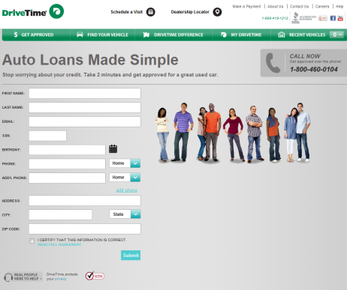
Recent Operational Enhancements
Retail Experience
Collections
Evolution to a more client-centric focused brand, promoting DriveTime as a courteous, transparent, respectful and trustworthy business
Fully centralized collection system with call centers in Arizona, Texas and Barbados
  Flexibility to close underperforming dealerships without disrupting collections
Customers can make cash payments through electronic payment network at over 4,000 Wal-Mart stores and more than 17,000 other locations nationwide
Beginning in 2012, all vehicles are equipped with anti-theft GPS devices
Opened 21 new retail-focused dealerships over the past two years
Existing dealerships have been remodeled with a spacious contemporary design, unique signage and flooring, and modern furniture and color patterns
Product / Channel Expansion
Internet
Launched in December 2011, GO provides subprime auto financing to third-party auto dealerships to provide incremental profitability
In Q4 2012, DriveTime began offering the DriveCare® limited warranty as a separately priced service contract in dealerships in Tennessee, Virginia and Ohio (expanded to Los Angeles in 2013)
Launched in January 2013, Carvana is a new sales channel that enables customers to buy cars, from click to delivery, 100% over the internet
Extensive investment in DriveTime.com and mobile applications, which provide customers comprehensive information about inventory, the credit application process, and scheduling dealership visits
  Over 57% of sales generated by customers who complete application prior to vising a dealership
  6.6 million visits per year
After purchasing a vehicle, MyDriveTime.com allows customers to set up ACH payments, make one time payments and view account balances
We Bring People and Cars Together.
Notes:
GO – Finding it does not cannibalize DT, GO is a way of picking up business in areas where DT is not as well as getting customers that DT’s competition was capturing through being able to finance with CAC, Westlake, etc. (Reason for going into indirect lending is that we had all of the infrastructure in place to compete in this sector so why not utilize it.)
Leverages DT’s credit scoring model, collections system, knowledge of vehicle purchasing and vehicle performance for warranty, etc.
Carvana – Based out of Atlanta
Collections – GPS: Sell as a theft protection device, no starter interrupt, facilitates the recovery time in repossession process, sends a signal when battery is dead
- Other things it could be used for: Locating vehicles in an inventory audit, geo fence to receive notification when vehicle is outside of boundary, be alerted when gone over a certain speed, can be used for collections (i.e. turn on when no contact with a customer over a certain number of days)
-Unbundling – driver is pricing on internet, discuss GAAP vs. economic effect, Tax effects (end up in a better place from a cash flow perspective), Slide in supplemental deck we can discuss.
6 dealerships closed 7/1/11 to 6/30/13

Slide 14
SECTION 2: CREDIT SCORING & LOAN SERVICING
14
We Bring People and Cars Together.

Slide 15
Expertise in Credit Risk Management through Origination Strategy and Analysis
Our scoring system is the key component in determining origination strategies
Information used by the credit scoring system is gathered from multiple sources
  Credit bureau
  Debit bureau
  Alternative data sources
Credit scoring system is automated
  Dealership personnel input credit application data and initiate the credit scoring process
  Internal models are housed on SQL Servers at corporate office
  After the application data is entered, the scoring process takes a few seconds
Evaluated predictiveness of many techniques, including:
  Segmentation
  Iterative variable selection
  Ensemble modeling
  Predictiveness based on out of sample testing
  Cross validated GINIs
15
We Bring People and Cars Together.
Notes:
Take basic information such as: SSN, Address, employer, but also look at:
Credit Bureau – Transunion, Experion, Equifax
Debit Bureaus – look at how many times a customer has NSF’d, how many bank accounts opened, how many times a person has ordered checks, etc.
Alternative Data Sources – ID Analytics/Precise ID, FIS/LexisNexis – access to public records
Assign points across 80+ attributes from these sources to determine a customer’s credit grade.
Scoring: Look at Credit Grade (taking information from above) separate from Income – look at the 2 together to structure the deal – these two items combined determine the down and the max payment (Car value also helps set max term)
-Sell the less expensive car to higher risk profile and more expensive vehicle to lower risk customer
-Look at: To determine Down: customer score/car
To determine Term: customer score/car
Take into account PTI: customer – place a lot of stock in verifying and calculating income
At point of sale – verify income, also have a verifications team on the back end that review contracts for process improvement going forward
In scoring model:
Experian/Equifax/Transunion – weight 50% of predictiveness
Other sources: Debit/Credit bureaus 50% of predictiveness
Gen 8 in Q4 – main change will be accessing data that we’ve pulled from these sources over several years that we’ve been able to catalog and have consistency in referencing the data being pulled (shifting back to primarily lexisnexis/credit bureaus – difficult to keep up with data being pulled from several bureaus as they don’t always notify their customer when making changes in the feed which can throw off model. Lexisnexis also now incorporates many of the data elements that were provided by the other sources.
Vantage Score – bureau product that is launched to compete with FICO score
Overall – tend to be more of a credit based lender vs. collateral based (like a CAC who tends to focus more on LTV’s etc.)

Slide 16
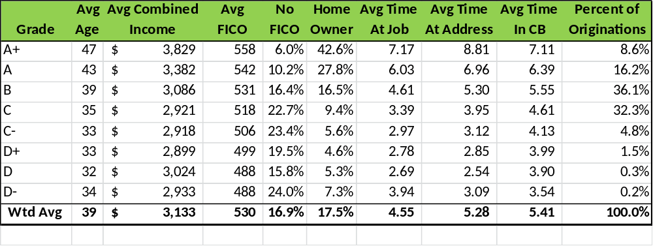
Our Customer Demographics
We segment the sub-prime market into eight credit grades using our proprietary credit scoring models
Note: Based on loans originated 7.1.2012 – 6.30.2013
Notes:
This looks at the population on our books:
Percent of originations: Booking/capture rate for A’s/B’s typically 1 out of 2, vs 5 out of 100 D’s (typically see 3x higher loss rates with D customers)
Minimum to purchase a vehicle – Over 18 yrs. Of age and $1,500 in income
Note: Customers with bankruptcy tend to perform better than non-bankruptcy customers
Non-defaulters tend to walk away w/better credit 500 to 600/625
A’s = lower downs/Higher PTI’s/Longer Terms
D’s = higher downs/Lower PTI’s/Shorter Terms
Past two – three years a customer had a credit bureau pull prior to coming to us – not seeing as many which means they are likely getting picked off.
\\phx-corp-fs01\departmental shares\Treasury\Presentations\2013\2013-2\Requests\Customer Demographics LTM ending 6 30 13.pptx

Slide 17

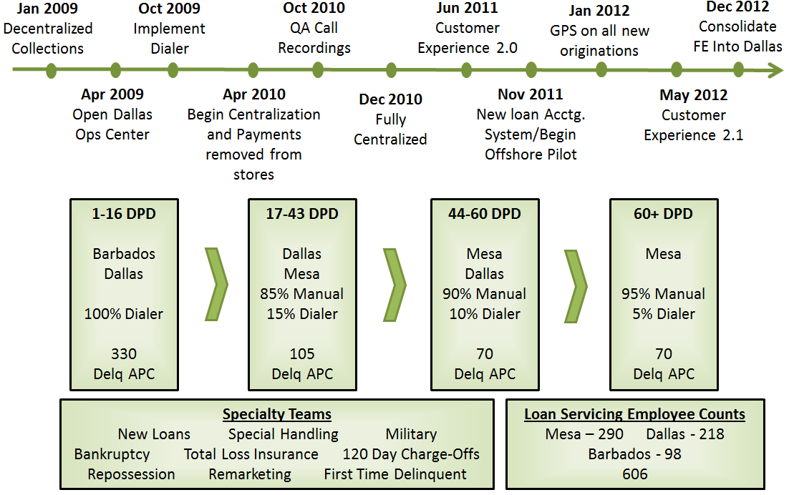
We Bring People and Cars Together.
Notes:
Talk about staffing levels being back -Beginning of 2013 @ 150 APC in the 17 – 43 DPD bucket
Customer Service 2.0 on timeline – eliminated invasive stuff like door knocks/implemented training from call monitoring, etc.
Customer Experience 2.1 – Additional training related FDCPA (Fair Debt Collection Practices Act) – restricted reference contacts to high delinquency loans, reduced intraday call frequency on early delinquent, implemented call delays based on contact and payment recency (note: now shifting away from some of these initiatives, only noted in case we need to discuss)
Recently added a 1st time delinquent group: 11 day no contact, bad phone number, no payment
Also have a customer service group taking inbound calls to handle account inquiries, customer relations, payment methods/locations, account information, etc.
2013 initiatives – may shift to see both centers collecting across all buckets (recently shifted Dallas to collect some in the 44 – 60 DPD) to have better career pathing and also see if there is some efficiency based on time zone/location
-integrate GPS use into collections system, web based collections system (touch screen to have phone dial a number, eliminate the manual dialing, tracking of call times in system, etc.)
Turnover – typically see 50% of attrition w/in 1st 90 days (2012 Annualized = 72%, 2013 tracking around 60%)
May have to discuss difference between industry and how we handle charge-offs/recoveries
Bad Bank group = 9 ee’s, Go financial Collections = 50 Employees , Dialer = Avaya – 3 outbound teams in Barbados, 2 in Dallas (60%/40% split)
See also Joe’s notes on servicing/collections:
\\phx-corp-fs01\departmental shares\Treasury\Presentations\2013\Support\Loan Servicing Timeline & Current Strategy.pptx

Slide 18
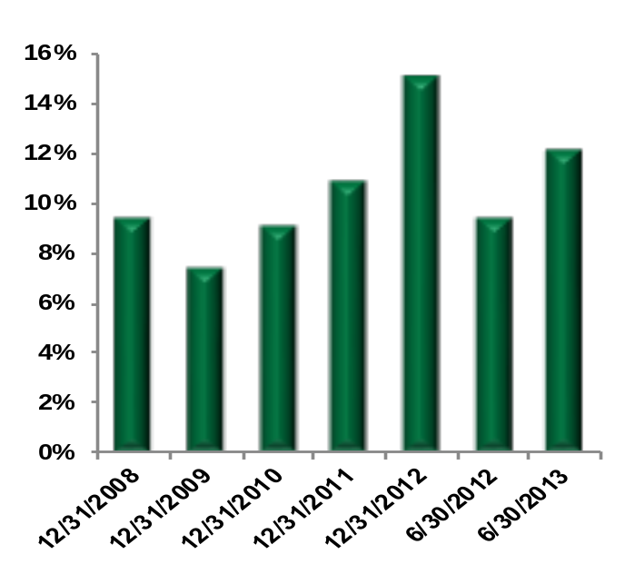
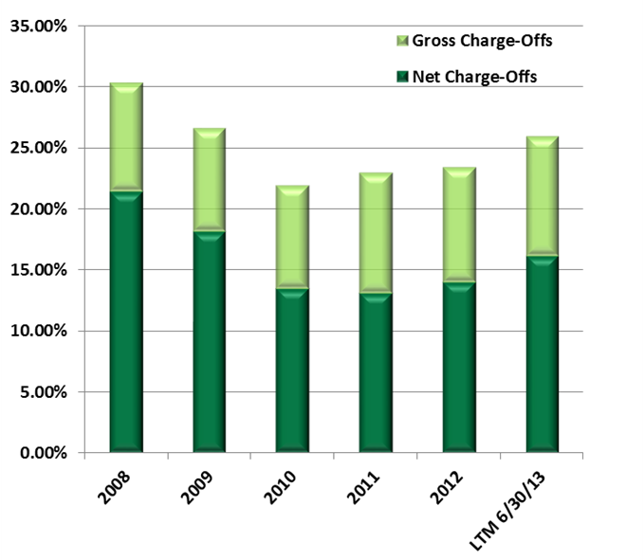
Portfolio Performance
Loan servicing disruptions tied to proposed sale in 2012 resulted in increased delinquencies
  Closed two front end collection centers, hiring freeze in other centers
    At peak, the front end understaffed by 100 collectors (37%)
  Back end collections experienced all-time best roll rates
    As a result, a lower percentage of delinquent loans have charged off
Post termination of sale transaction we have taken steps to increase staffing to targeted levels
  Delinquency levels have been steadily normalizing through first 6 months of 2013
Portfolio Delinquencies 31-90 Days ⁽¹⁾
Charge-Offs by Year (% Avg. Portfolio)
430 bps
270 bps
Delinquencies are presented on a Sunday-to-Sunday basis, which reflects delinquencies as of the nearest Sunday to period end. Sunday is used to eliminate any impact of the day of the week on delinquencies since delinquencies tend to be higher mid-week.
18
We Bring People and Cars Together.
Notes:
Confirm approach/talk off’s on plane…
-30% of new customers come in with a trade in vehicle
-Approximately 45% of customers get to a full payout on the loan
-repeat customers typically buying our Euro vehicles – tend to perform better than an A customer even if upon repeat scoring they are a C/D customer
\\phx-corp-fs01\departmental shares\Treasury\Presentations\2013\2013-2\03 -Net CO by Quarters_0613.xlsx

Slide 19
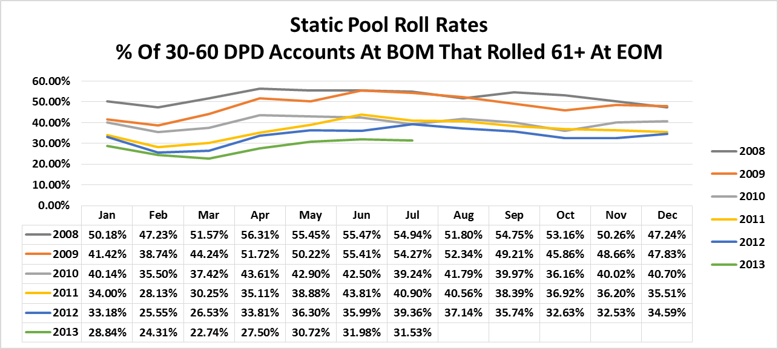
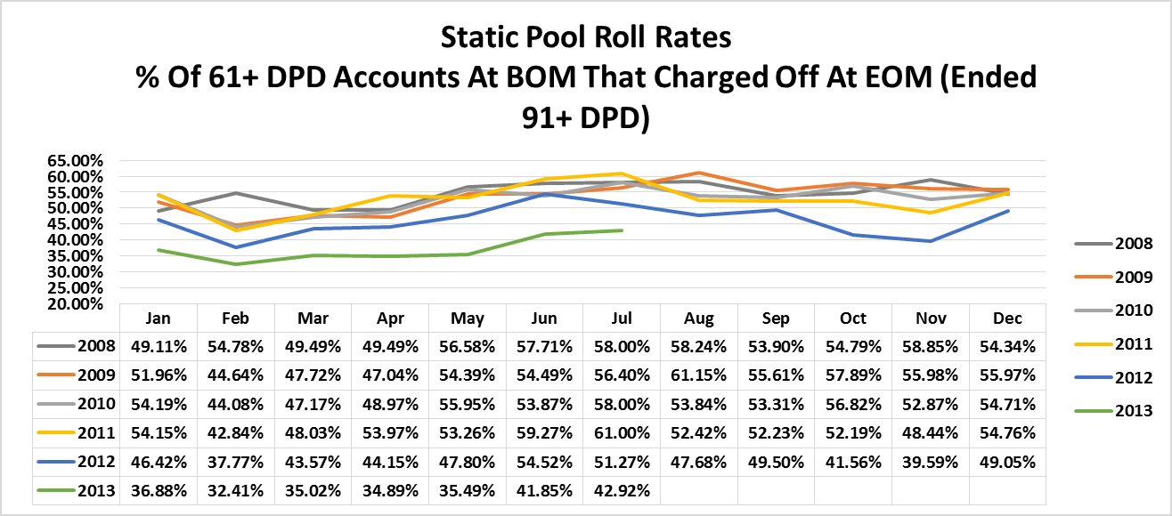
Late Stage Roll and Charge-Off Rates at
All-Time Lows
19
We Bring People and Cars Together.
Notes:
- May only discuss this slide if the investor wants to hear the effect on the portfolio due to Santander
The 10% - 15% that don’t charge off at 90 past due have to have made a qualifying payment of $50 within the previous month
\\phx-corp-fs01\departmental shares\Treasury\Presentations\2013\2013-2\Requests\SaveRateTracking.xlsx

Slide 20
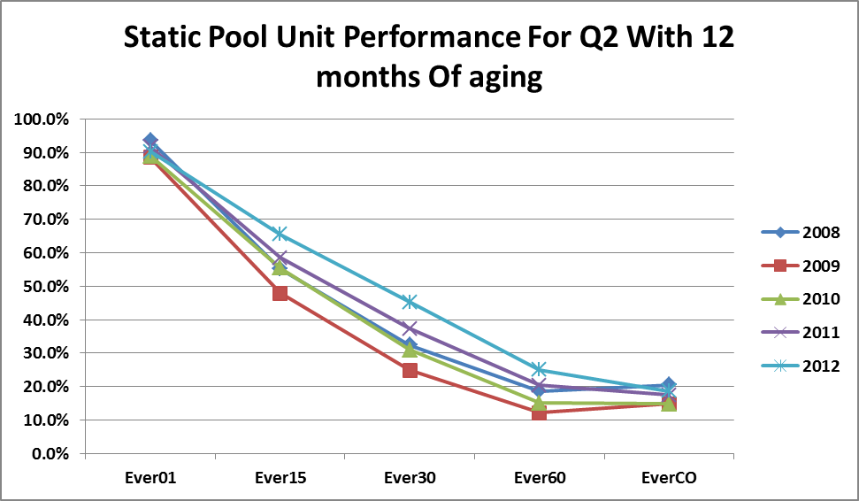
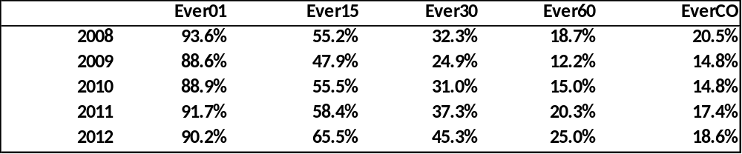

Static Pool – Unit “If Ever” Days Past Due
We Bring People and Cars Together.
Notes:
This is the percentage change from Q1 “if ever’s” w/12 mos. aging vs. Q2 “if ever’s” with 12 months changing – essentially shows that a smaller percentage of loans are ever getting into the later stage delinquency buckets (i.e. the increased collections staffing and changes are showing signs of paying off).
\\phx-corp-fs01\departmental shares\Treasury\Presentations\2013\2013-2\Requests\Ever DPD by quarter from Dan Ower.xlsx

Slide 21
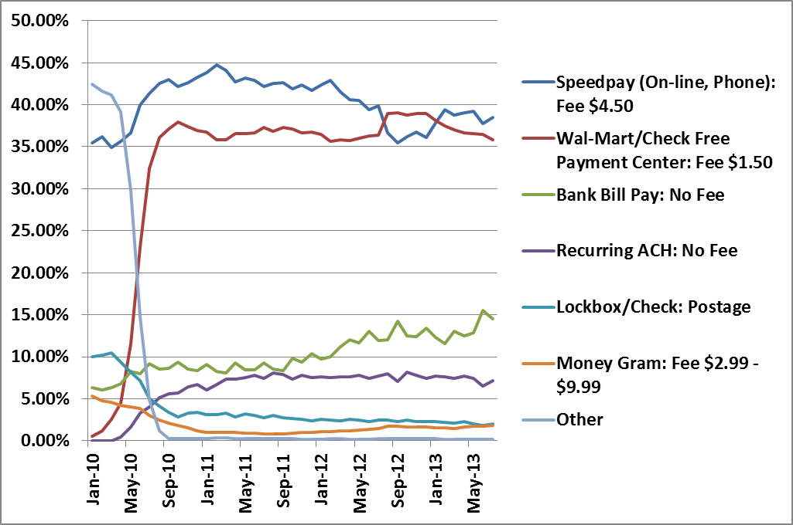
DriveTime Payment Channels
Fully removed in store payments in Q4 2010.
DriveTime accepts an average volume of 220k payments across all payment channels per month.
DriveTime ranks as the number one payee at Wal-Mart through the CheckFree Pay network.
Currently using text to send payment reminders to customers. Adding the option to make payments using text in September 2013.
*Other payment methods include Western Union Quick Collect, Trustee Checks, etc.
21
Notes:
-Placing continued emphasis on signing up for recurring ACH at point of sale
- Life of loan cost savings for recurring ACH – typically see an additional $200 - $300 in cost savings
\\phx-corp-fs01\departmental shares\Treasury\Presentations\2013\2013-2\Requests\PmtCount_ByType_Through July 2013.xlsx (Updated 8.16.2013)

Slide 22
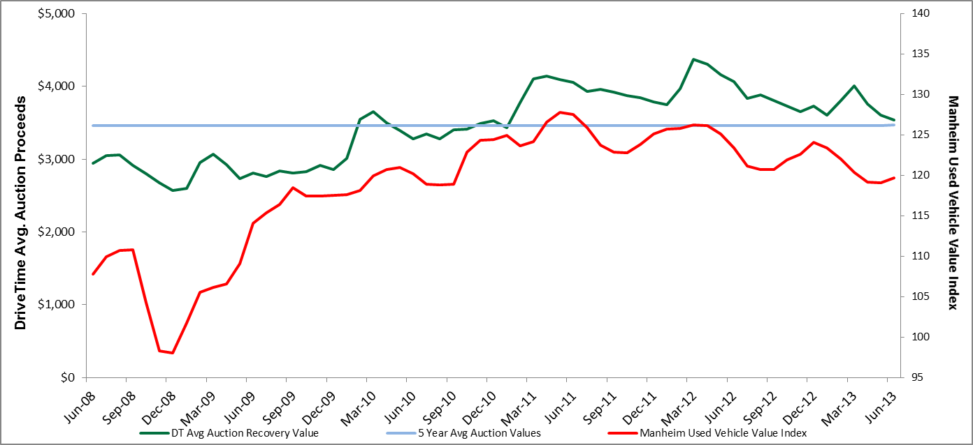
Auction Vehicle Recovery Values
DriveTime recovery values tend to be less volatile than the market averages
  More of a built in floor on the lower priced used DriveTime vehicle (6 – 8 yrs. old) vs. more volatility in the newer makes/models (1-5 yrs. old)
  DriveTime portfolio turns over every 24 months on average vs. other prime/near prime lenders whose portfolio’s do not turn over as quickly
Notes:
MMR Index – auction only index
NOTE: Wholesale/Retail Blackbook – more accurate than MMR – gets down to trim level
For our business model – vehicle pricing coming down is a net win for us – (i.e. better margin on sale – not better for a securitization trust)
\\phx-corp-fs01\departmental shares\Financial Reporting\Monthly Financials_DAX\Financials 2013\Financials June 2013\Reporting\Lender Presentation Data - June 2013.xls – Slide 17 Recovery

Slide 23
SECTION 3: FINANCIALS
23
We Bring People and Cars Together.
Notes:
23

Slide 24
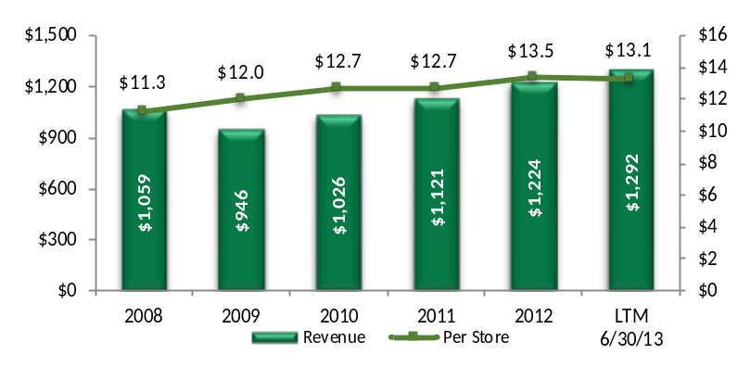
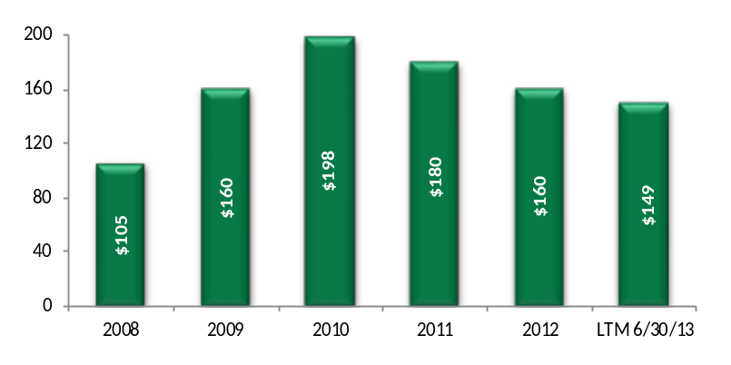
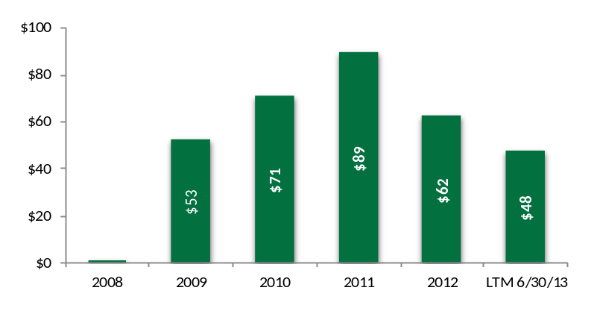
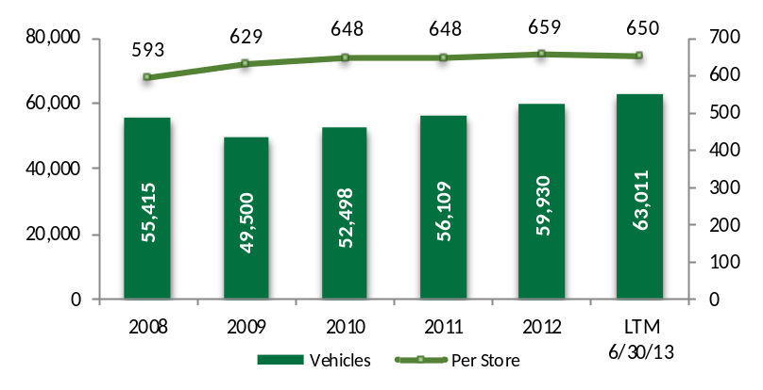
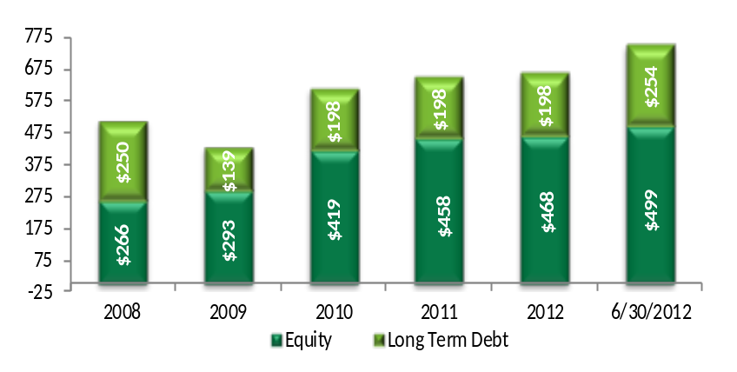
History of Profitability Through Credit Cycles
Proven ability to manage through all credit cycles
Revenue
Adjusted EBITDA
($ Millions)
($ Millions)
Vehicles Sold
Long Term Capital
($ Millions)
$753
$617
$656
$665
$516
($ Millions)
$432
*$50M add-on to Sr. Notes in May, 2013
Notes:
Revenue – composed of vehicle sales and interest income
Struggle over the past few years has been the increase in cost of car: Countered by changing a few items due to customer not being able to afford the increase in vehicle: slightly older car w/more miles (i.e.Quality of Car), slight decrease in margin, and increase in term of loan to keep an affordable payment level – just now starting to see vehicle prices level (and possibly start coming down)

Slide 25
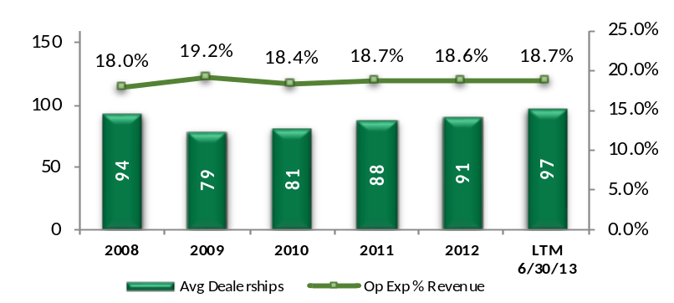
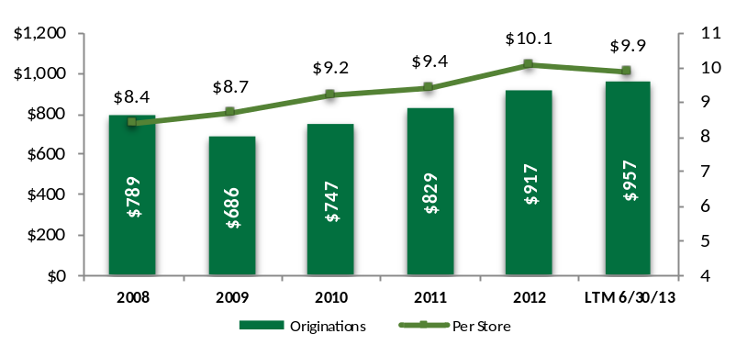
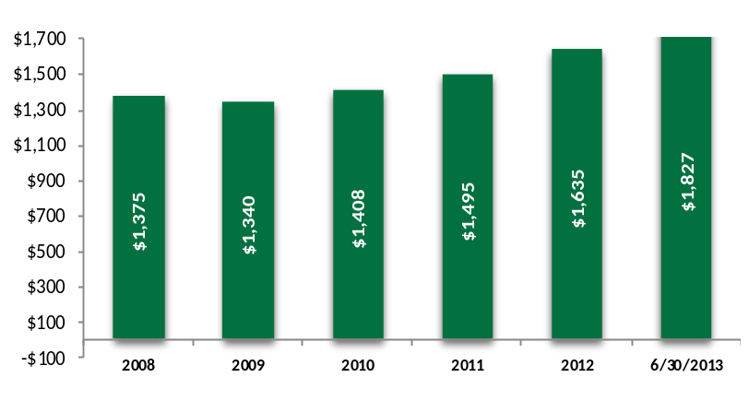
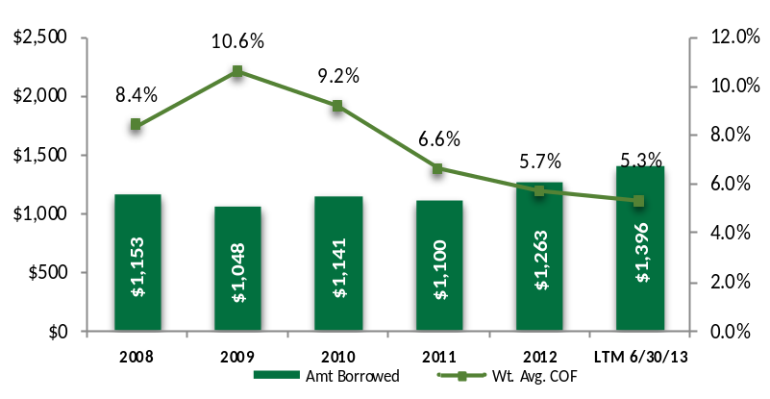
Operational Metrics
Closed dealerships in 2008 & 2009 in response to reduced access to funding
Dealerships ⁽¹⁾
Originations
($ Millions)
Finance Receivables
Cost of Funds
($ Millions)
($ Millions)
⁽¹⁾ Operating Expenses exclude store closure costs (2008 & 2009), legal settlements (2009), CFPB & SCUSA deal costs (2012), and non cash compensation expense (all years).
Notes:
Main focus is to point out how we continue to grow the business

Slide 26
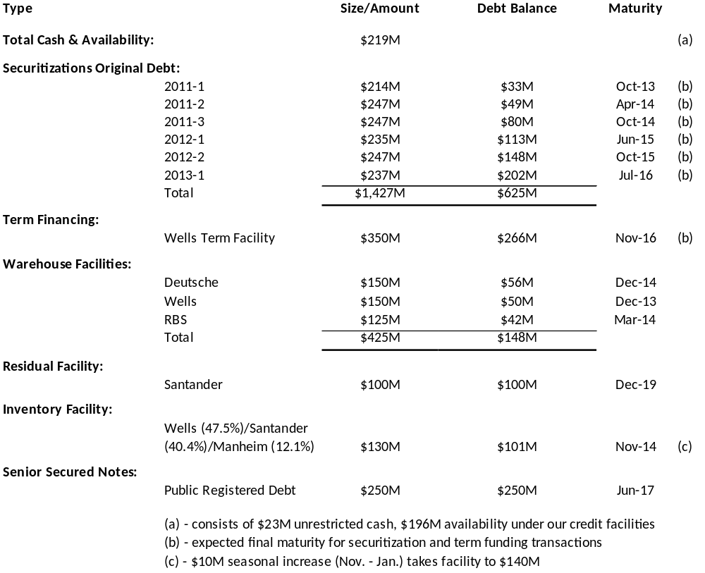
Debt & Liquidity Overview (7/31/13)
Notes:
Fairly conservative Balance Sheet – single shareholder- w/majority of wealth tied into the business
Items/clauses in facility documents that we did not have previous to recession/downturn: - eliminated subjective mark to market (ability to have a advance rate reduction/immediate cash call)
-foreclosure rights are limited (unable to sell out collateral from underneath
- more favorable term out features (Wells facility performs like a securitization for 1 yr., then turbo’s down 1 year.
-separate SPE’s w/non recourse back to the company
Inventory Facility is a borrowing base facility
RBS facility is explicitly rated A by DBRS
Sr. Notes rated B/B- by S&P/Moody’s – callable in 2014 @ 106, now trading around 107 - 108
\\phx-corp-fs01\departmental shares\Treasury\Presentations\2013\2013-2\Requests\Debt & Liquidity With Rates 7-31-13.xlsx

Slide 27
SECTION 4: SECURITIZATIONS
27
We Bring People and Cars Together.
Notes:
27

Slide 28
DriveTime Securitization Program Overview
Issued 46 securitizations dating back to 1996
  $5.8B in bonds
  $7.8B in contract principal
Six currently active securitizations
  Current debt outstanding $625M ($1.4B at issuance)
  Securitizations are rated by S&P and DBRS
    Added Kroll Bond Rating Agency in 2013
Serviced by DT Acceptance Corporation (DT Credit Company)
  Loan servicing centers in Mesa, Arizona & Dallas, Texas
  Wells Fargo is back-up servicer
All contract receivables originated by DriveTime dealerships
  All company owned
  No receivables purchased from third parties
28
Notes:
Updated from Monthly Dev Summary tab through 2013-1 and using July 2013 amounts

Slide 29
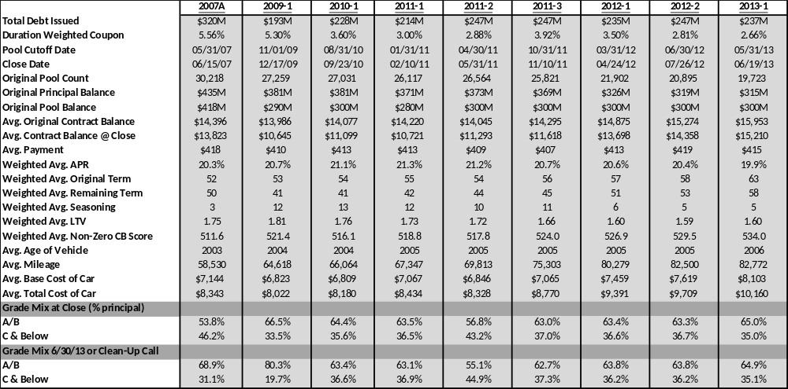
Recent Securitization Information
Notes:
Usury rates vary by state – vary by grade/car, etc.
Sales Tax recovery – usually results in 4 to 5 points which is not dependent on car less volatile
\\phx-corp-fs01\departmental shares\Treasury\Presentations\2013\2013-2\Securitization Information updated for 2013-2 Roadshow.xlsx

Slide 30
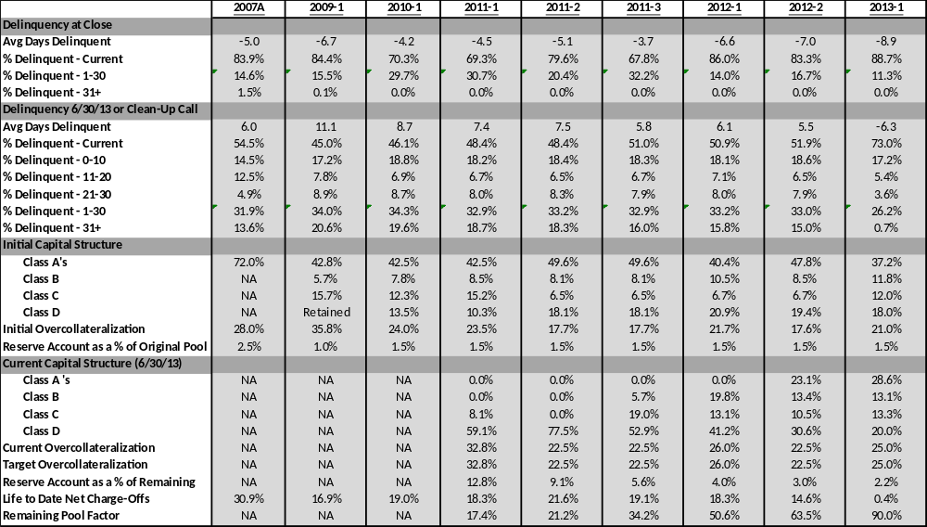
Recent Securitization Information (Cont’d.)
Notes:
Note: net loss expectation on 11-2/11-3 were 23-24% vs. net loss expectation on 13-1 (and likely 13-2) will be 26.5%
\\phx-corp-fs01\departmental shares\Treasury\Presentations\2013\2013-2\Securitization Information updated for 2013-2 Roadshow.xlsx

Slide 31
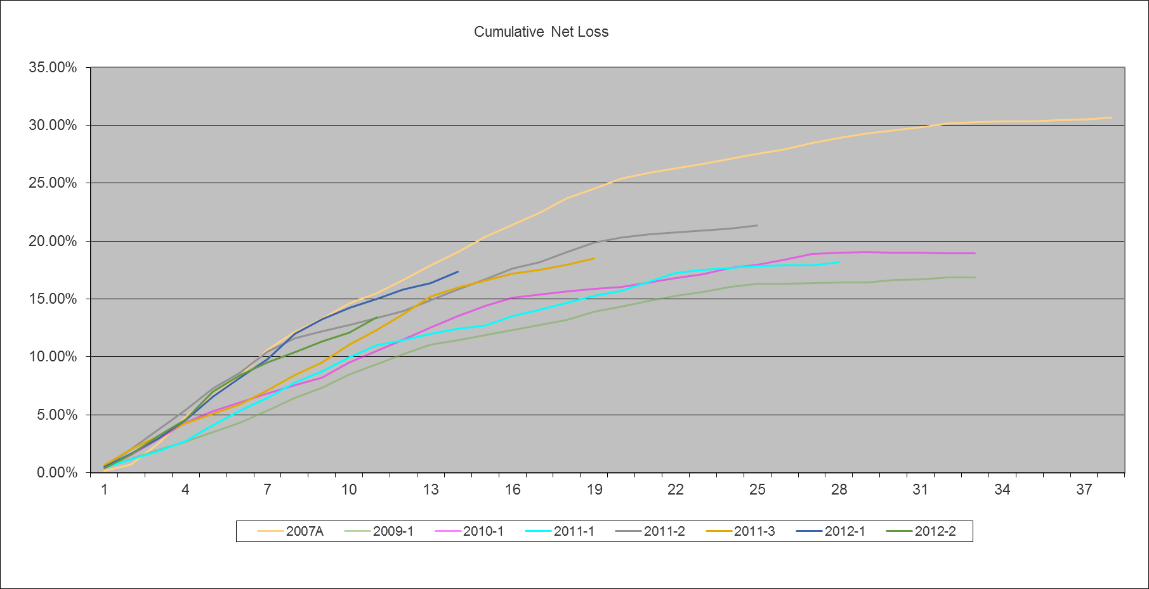
Portfolio Performance (6/30/13)
Cumulative Net Losses by Securitization
Notes:
2007 A – includes more C-/D loans (before tightening of credit) and these loans also felt the effect of the recession
2009/2010 vintages are likely some of the best vintages we’ll ever see – credit was tight and DT was able to sell to a better customer
\\phx-corp-fs01\departmental shares\Treasury\Presentations\2013\2013-2\Cumulative Net Loss Graph.xlsx – This was created by modifying the monthly dev file

Slide 32
SECTION 5:LEGAL & REGULATORY UPDATE
32
We Bring People and Cars Together.
Notes:
32

Slide 33
Legal and Regulatory Update
On March 4, 2013, Credit Acceptance Corporation (“CACC”) filed a patent infringement complaint against DTAG, DTAC and GO in federal court in California
  CACC also filed a similar infringement lawsuit against WestLake simultaneously
  CACC alleges infringement of its U.S. Patent No. 6,950,897, entitled “System and Method for Providing Financing”
  The complaint seeks injunctive relief as well as awards of damages and attorneys' fees
  The complaint is not specific about what DriveTime is doing that infringes their patent
  At this time, DriveTime does not believe it is infringing upon CACC’s patent and will vigorously defend against these claims
  DriveTime successfully moved the case to the Federal Court in Arizona
On April 12, 2012, the Consumer Financial Protection Bureau (the “CFPB”) delivered a Civil Investigative Demand to DTAG requesting that DTAG produce certain documents and information and answer questions relating to certain components of the business of DTAG and its affiliates
  The CFPB has not alleged a violation by DTAG of any law and DTAG is cooperating with the CFPB's requests for information
  DriveTime has provided the documents and information initially requested by the CFPB
  DriveTime has also received limited requests to clarify and supplement certain information provided to the CFPB, and make three employees available for interviews
  - DriveTime has provided the additional information within the agreed upon timeline, and the interviews have been conducted
We Bring People and Cars Together.
Notes:
Adding a compliance group tied to recent CFPB guidance w/policies, procedures (annual reviews of all contracts, forms, etc.)
DT has consistently done fair lending reviews in the past – results have been clean
Did a review on dealer participation (CFPB focusing in on discrimination based on race, sex, ethnicity) – completed in May – results came back clean
Typically use Ballard Spahr, McGlinchey, Hudson Cook
Other competitors also have received CID’s: JD Byrider, CarHop,
Interviews with CFPB were with head of collection facilities in Dallas and Mesa as well as one individual related to credit bureau reporting

Slide 34
Disclaimer
These materials were prepared solely for the person to whom it is transmitted, is provided for informational and discussion purposes only, and is not, and may not be relied on in any manner as legal, tax or investment advice or as an offer to sell or a solicitation of an offer to buy securities. The materials are the sole property of DriveTime. We do not guarantee or represent the accuracy of the information provided. These materials may include forecasts or other “forward looking statements.” Statements that are not based on current or historical fact, including statements about DriveTime’s beliefs or expectations are forward looking statements. Any such forward looking statements speak only as of the date they are made and reflect the current projections, expectations or beliefs of DriveTime based on information currently available to the Company. Forward looking statements involve inherent risk and uncertainties and future forecasts, events and actual results may be materially different because of risks, factors, changes and/or uncertainties, some of which we cannot predict or quantify. We have no obligation to update or revise these materials. In accepting these materials, you have agreed that they contain trade secrets and/or highly confidential information and that you will hold the information contained or referred to in confidence. Except as may be required by law, you cannot distribute these materials or the information in these materials to any other person without our written consent other than within your organization on a need to know basis and to your professional advisors.
34
We Bring People and Cars Together.

